Slide 1
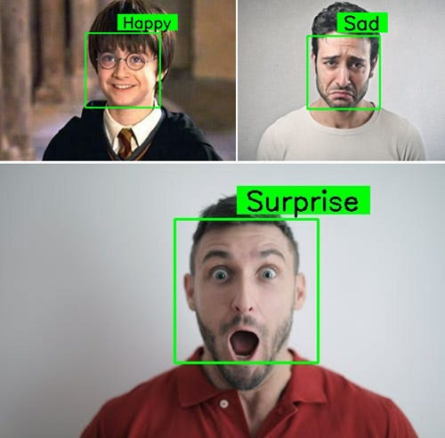
Facial Detection on Human Emotions
Kaifeng Lu, Ke Hu, 245 Team Alchemist
Problem formulation:
Task(T): Detecting and classifying human emotions based on facial expression in image or videos.
Experience(E): Training the model on a dataset of labeled facial image.
Performance measure(P): Accuracy of prediction in validation data
Motivation:
How to improve the HCI in entertainment and gaming experience based on emotion detection?
Methods
Choice of model: YOLO -v8
Preprocessing: encode expression of emotion into numerical labels(e.g. happiness = 1).
Modifying Model: Configure YOLO v8, then adjust hyperparameters such as learning rates, batch size and epochs, output layers
Training: Transfer learning with pre-trained weights, choose loss function that best fit, feed training data set.
Evaluation Plan
Database: AffectNet or FER2013
Evaluation Metrics:
Accuracy = (test size – correct size)/test size
which is easy to calculate and effective to reflect the correctness.
Fine-turning:
Train Only the Output Layers Initially
Modify the model's output layer(number of emotions).
Start with a normal learning rate
Graduate lower the learning rate
Regularization with weight decay

